Slide 1
Diamond house
All Project

Slide 2
Information gathering
Wireshark – We initially ran the virtual machine along with wireshark to find the IP address for the web interface.
Hex Editor – We used a hex editor on the various virtual machine files to find any plain text that may be useful. We managed to find a list of all the usernames with their user ids.
Port Scanner – We did a port scanner using one that we developed to gain a list of all the open ports, their services and the versions.
Robots – We also made a python script to grab the robots.txt file for any given url which also showed us some of the directories.
HTML – as we now had access to the web interface, we could inspect the html elements. We were able to find the server operating system and version which as well as a piece of javascript that pointed to cg-bin/status.

Slide 3

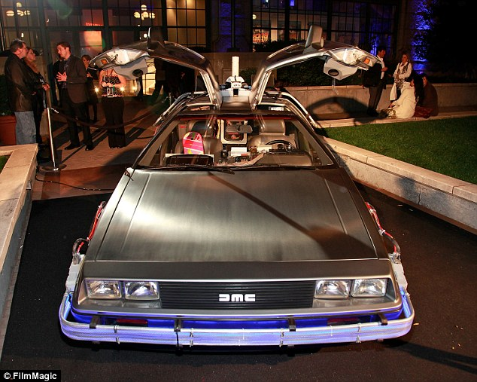
Passwords
We used the various usernames to find more html pages on the interface. We tried combinations of the usernames with passwords that were related to their pictures.
We gained the password for terry which was "shortbread" and the password for tono which was "delorean".

Slide 4
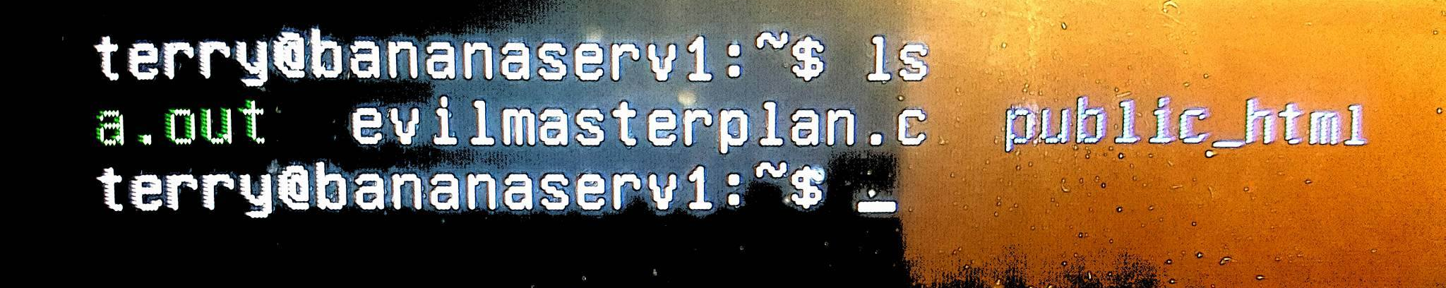
Suspicious terry
We logged in as Terry on the virtual machine, but used SSH instead for different features.
Looked around directories and found evilmasterplan.c.
Used nano to view the contents and compiled using gcc.
We now had root.
We changed the password for felonius, with a user id of 0.

Slide 5
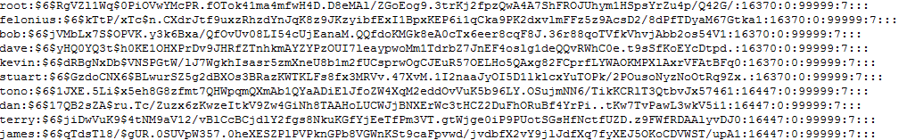
Shadow file
From felonius we accessed to the shadow file.
We used the commands script and scp to record and copy the contents of shadow to the desktop.
We ran this through John the Ripper and gained the passwords for Kevin and James.

Slide 6
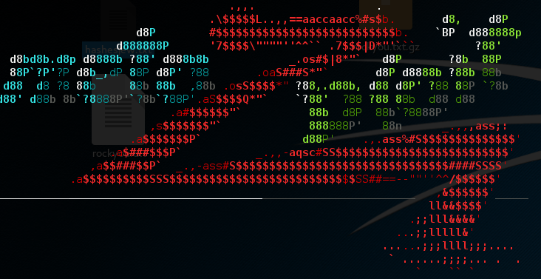
Shellshock
From metasploit, we ran a shellshock exploit that allowed us to run commands or files from within the server.

Slide 7
Ransomware concept
All Project

Slide 8
Ransomware #1
When x amount of changes are happening to a system, the program will start.
It will look at x amount of bytes for an x amount of files that are being changed.
Using a cross entropy algorithm, it will detect the amount of randomness in the data.
Cross entropy is used to calculate the distribution of unnatural data and give a result.
With this result, it will be converted to a value between two integers such as 1 – 1000.
For example, the higher the value, the more unnatural distribution of data.

Slide 9
Ransomware #1
If a certain amount of these files are returning a higher than normal value, then they are most likely being encrypted or compressed as encrypted files look very random.
A halt on the system can prevent the encryption from continuing, and a verification through email can verify if the encryption is being done by the user.
If it is not the user, then the program editing or encrypting the software can be terminated and quarantined.
If it is, then the process can continue.

